Slide 1
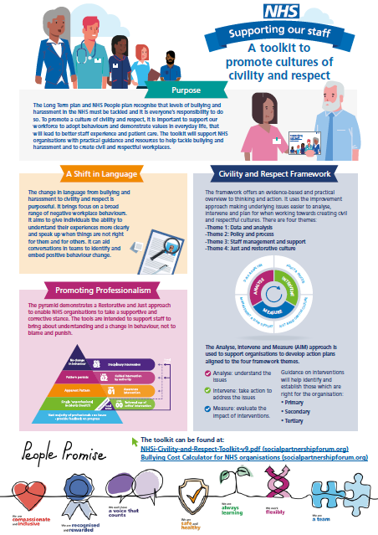
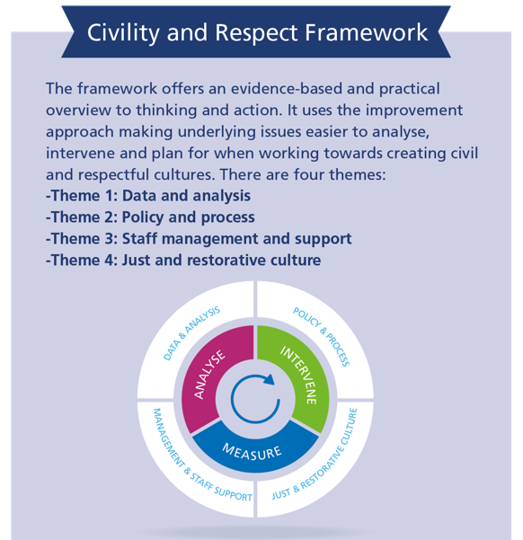
NHS Civility and Respect Programme

Slide 2
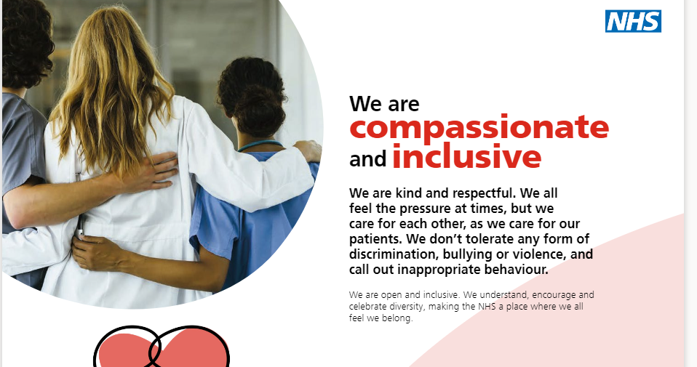

Slide 3
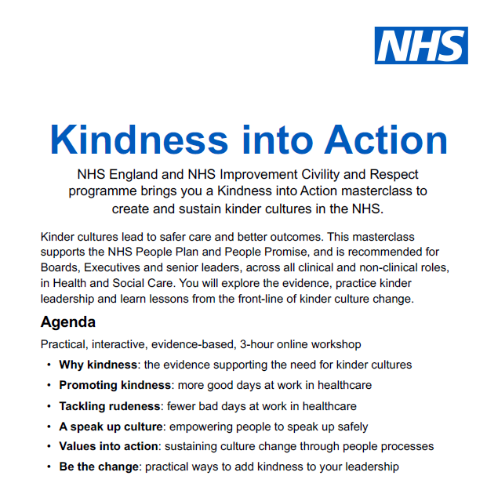
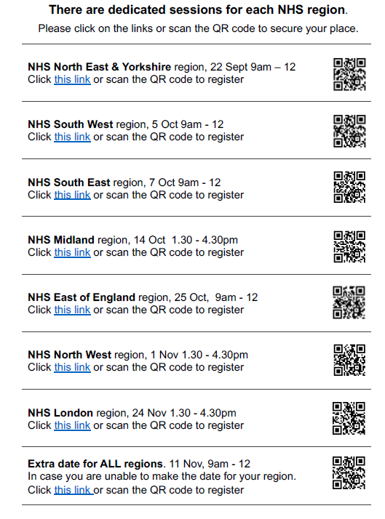

Slide 4
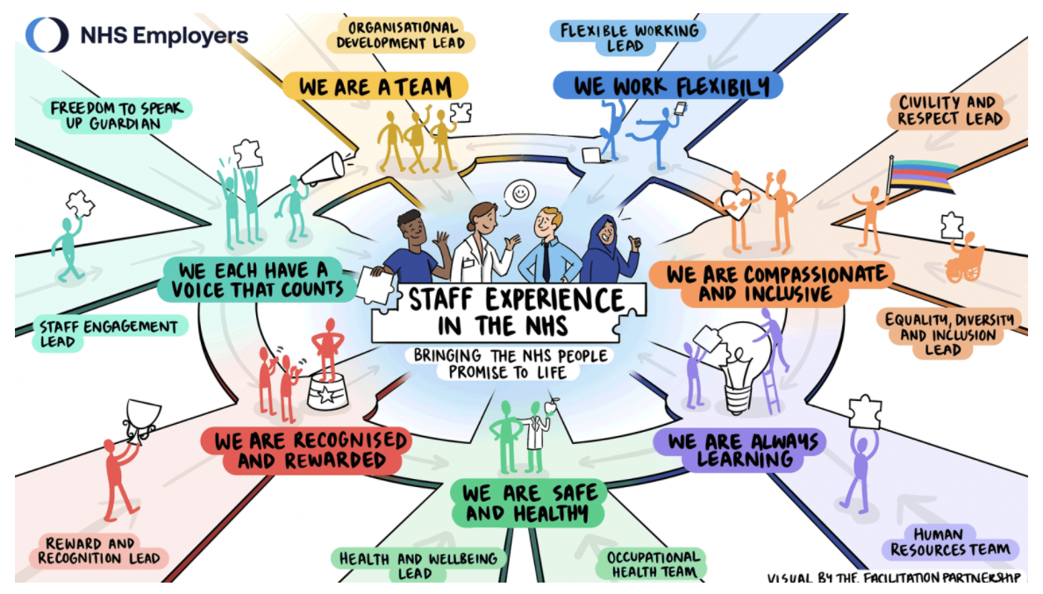

Slide 5
The Heart, Head and Hands of Leadership
Compassionate, Curious, Collaborative

Slide 6
Heart
We are Compassionate
We are inclusive, promote equality and diversity, and challenge discrimination.
We are kind and treat people with compassion, courtesy and respect.
Head
We are Curious
We aim for the highest standards and seek to continually improve harnessing our ingenuity.
We can be trusted to do what we promise.
Hands
We are Collaborative
We collaborate, forming effective partnerships to achieve our common goals.
We celebrate success and support our people to be the best they can be.

